Slide 1
Open Badges
Overview
Notes:
Hi this is Bernadette Parry from eWorks and with a brief overview of Open Badges and Moodle

Slide 2


Open Badges – what are they?
Online
Open technical standard
Hold information
Notes:
Online - Badges are distributed online – visual representation of achievements, learning, skills, interests, competencies
Open source – free software and based on an open technical standard **Hold information – the badges carry information (metadata) which tells who issued the badge, a contact email, name, description, course, criteria, date issued, expiry, and evidence

Slide 3
Notes:
Student earns badges, maybe from different organisations

Slide 4
Notes:
Learner uploads the badges to their Mozilla backpack

Slide 5






Notes:
Student can display the badges in Moodle, Mahara, LinkedIn, Twitter, Wordpress, Facebook, a web site
Assists with life long learning, as the learner can collect all badges earned in one place

Slide 6

The process
Teacher creates a badge, adds it to a course
Student earns badge
Uploads it to Backpack
Display badge on LinkedIn, Facebook, Mahara, etc
Notes:
To use badges in Moodle:
Teacher creates a badge, adds it to a course – with criteria for earning it
Student earns badge
Uploads it to Backpack
Display badge on LinkedIn, Facebook, Mahara, Moodle, etc

Slide 7
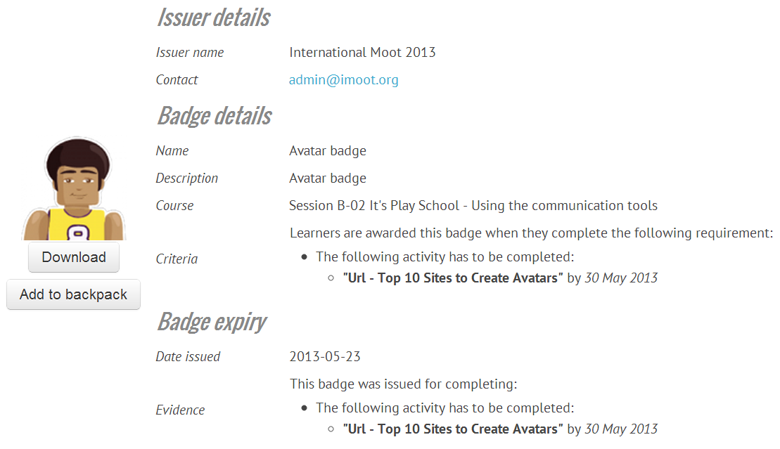
Badge metadata
Notes:
For example, the Metadata – data about the badge (issuer name, criteria, description, etc)
In Moodle, the Evidence is the same as the Criteria

Slide 8
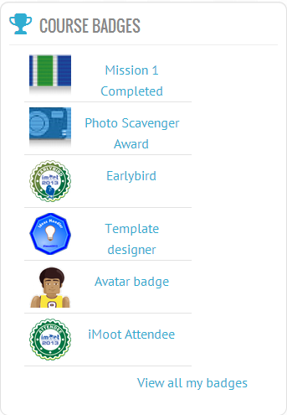
Block – My latest badges
Notes:
New bock - My latest badges block
In Moodle, your users can see the My latest badges block – it can be added to My Home as well as to course
You can see badges earned in this Moodle, and users can also download badges earned from other sites into their Moodle profile.
You can see public badges of other participants

Slide 9
Be aware…
Badges can’t be revoked or edited!
Notes:
Currently, once a badge has been issued in Moodle it cannot be revoked – or edited.
So make sure that you are giving a badge to the correct users!

Slide 10


Create a badge
https://www.openbadges.me/
Notes:
Make a badge https://www.openbadges.me/
There are others
You can also make your own badges using software such as Photoshop

Slide 11

Backpack
Mozilla Backpack
Go to http://backpack.openbadges.org
Notes:
Mozilla have been the main driver for open badges, and they provide a place for people to store their open badges – called a backpack
Sign up for an account
Add email address and Next
Then add your password, and you will be sent an email for you to confirm the account details.
Once you have signed up, you can upload badges earned from anywhere, and keep them all in one place.

Slide 12
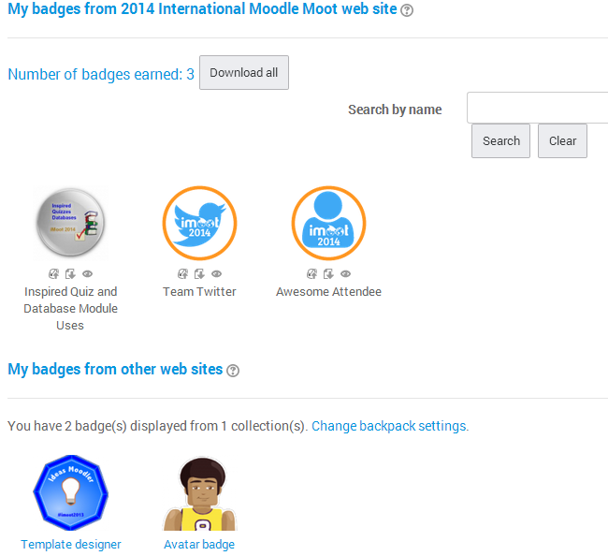
My badges
Notes:
You can upload your badges to your Backpack
Download badges to your local computer
Import badges received elsewhere

Slide 13
Notes about badges
Badge fatigue – they can become ‘noise’ with overuse

Slide 14
Notes about badges
Badge fatigue – they can become ‘noise’ with overuse
Good use – eg earn badge when you can use some particular equipment

Slide 15
Notes about badges
Badge fatigue – they can become ‘noise’ with overuse
Good use – eg earn badge when you can use some particular equipment
Have two people need to agree to issue it – double checking

Slide 16
Notes about badges
Badge fatigue – they can become ‘noise’ with overuse
Good use – eg earn badge when you can use some particular equipment
Can make it so that two people need to agree to issue it – double checking
Can’t be withdrawn within moodle (be careful about issuing)

Slide 17
Notes about badges
Badge fatigue – they can become ‘noise’ with overuse
Good use – eg earn badge when you can use some particular equipment
Have two people need to agree to issue it – double checking
Can’t be withdrawn within moodle (be careful about issuing)
Can use site-wide badges – eg for finishing a set of courses

Slide 18
Notes about badges
Badge fatigue – they can become ‘noise’ with overuse
Good use – eg earn badge when you can use some particular equipment
Can make it so that two people need to agree to issue it – double checking
Can’t be withdrawn within moodle (be careful about issuing)
Can use site-wide badges – eg for finishing a set of courses
Use for ‘gamification’

Slide 19
In conclusion…
Teacher creates a badge, adds it to a course
Student earns badge
Uploads it to Backpack
Display badge on LinkedIn, Facebook, Mahara, etc
Notes:
In conclusion, badges can improve the quality of your courses if used well, and can be very useful to learners. They are a bit like a certificate, but with metadata, so less easily edited.
Badge is made – you can use sites such as https://www.openbadges.me/
The criteria for earning the badge is set and stored with the badge
The learner earns a badge
Badges can be displayed via Facebook, WordPress, Tumblr, Mahara, web page, etc
Open badges stored in a Mozilla backpack for mobility – learners can take them when they leave your organisation

Slide 20
Further information
More detailed video from the Support Desk
http://docs.moodle.org/26/en/Badges
  Managing badges
  Badge settings
  Using badges
  FAQ
https://www.openbadges.me/

Slide 21

Notes:
Thank you for listening

