Slide 1

Open Badges
TrainingVC
Notes:
Hi this is Bernadette Parry from eWorks looking at Open Badges and Moodle

Slide 2
What we will look at
What Open Badges are
Notes:
What open badges are, and why we would use them

Slide 3
What we will look at
What Open Badges are
Create a badge
Notes:
How to create badges to use

Slide 4
What we will look at
What Open Badges are
Create a badge
Add a badge to a course
Notes:
How to add an open badge to a course

Slide 5
What we will look at
What Open Badges are
Create a badge
Add a badge to a course
How a learner sees and manages badges
Notes:
How a learner sees and manages badges

Slide 6
What we will look at
What Open Badges are
Create a badge
Add a badge to a course
How a learner sees and manages badges
Backpacks
Notes:
What backpack are and how to use them

Slide 7
What we will look at
What Open Badges are
Create a badge
Add a badge to a course
How a learner sees and manages badges
Backpacks
Some uses, warnings and comments
Notes:
And some uses, warnings and comments

Slide 8


What are Open Badges?
Online
Open source
Hold information
Notes:
mozilla have created the open framework for managing badges
The badges are png files
Online - Badges are distributed online – visual representation of achievements, learning, skills, interests, competencies
Open source –free software and an open technical standard (universal standard), so they are standardised and can be issued and verified by any organisation. Organisations could be a government agency, after school program, moocs, TAFEs, RTOs, etc
**Hold information – the badges carry information (metadata) which tells who issued the badge, a contact email, name, description, course, criteria, date issued, expiry, and evidence

Slide 9
Why use Open Badges?
Can represent a skill
Notes:
Can Represent a Skill
Learning doesn’t happen simply between K – 12, VET and university; learning happens over the course of a lifetime and frequently in informal settings
One of the main goals for developing open badges was to ‘Develop badges as an alternative accreditation/credentialing system’
The web and other new learning spaces provide exciting ways to gain skills and experience -- from online courses, learning networks and mentorship to peer learning, volunteering and after-school programs.
Badges provide a way for learners to get recognition for these skills, and display them to potential employers, schools, colleagues and their community.

Slide 10
Why use Open Badges?
Can represent a skill
Build a more complete picture of learning
Notes:
Build a more complete picture of learning
By displaying skills and achievements that traditional degrees and transcripts often leave out, badges can help lead to jobs, community recognition, and new learning opportunities.
Can see the full story of your achievements (wine making – not just make a wine (competent), but a badge for making a 94/100 wine),
Lifelong learning – maybe use for RPL (Recognition of Prior Learning) for a course you want to do
If a student doesn’t complete a qualification, it may represent some of the skills achieved

Slide 11
Why use Open Badges?
Can represent a skill
Build a more complete picture of learning
Transportable
Notes:
Transportable – can download badges, collect them in a backpack, display on social networking profiles, websites, wordpress, mahara, etc.
Can earn from multiple sources (eg certificate course, netball coach level1, etc), and save them all in a backpack.
There are plans around mahara for hosting and creating badges

Slide 12
Roles
Issuer
Notes:
3 main roles:
The Issuer – creates the badge, decides the criteria for earning the badge (skills/knowledge required, and how to assess/prove). This should be rigorous if you want the badge to hold any value.
The earner – anyone who wants to earn a badge – and they can demonstrate their mastery represented by the badge. (Girl Guides, swimmers, competency on a piece of equipment).
The earner will store their badges in a digital backpack
The Displayer – provides the ability to display the badges. Facebook, WordPress, Tumblr, Mahara. They will retrieve the badges from an earner’s backpack and display them for others to see

Slide 13
Roles
Issuer
Earner
Notes:
The earner – anyone who wants to earn a badge – and can demonstrate their mastery represented by the badge. (Girl Guides, swimmers, competency on a piece of equipment).
The earner will store their badges in a digital backpack

Slide 14
Roles
Issuer
Earner
Displayer
Notes:
The Displayer – provides the ability to display the badges. Facebook, WordPress, Tumblr, Mahara. They will retrieve the badges from an earner’s backpack and display them for others to see

Slide 15
Notes:
Open badges from a learner point of view
Student earns badges, maybe from different organisations
Perhaps the bandaging section of a first aid course from an RTO
The trips and falls secrion of a WHS course from a workplace
And a literacy part of a LLN course at a TAFE

Slide 16
Notes:
Learner uploads the badges to their Mozilla backpack

Slide 17






Notes:
Student can display the badges in Moodle, Mahara, LinkedIn, Twitter, Wordpress, Facebook, or a web site
Assists with life long learning, as the learner can collect all badges earned in one place.

Slide 18
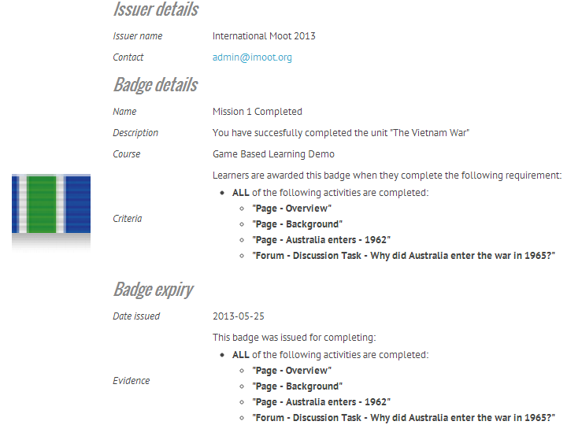

Slide 19
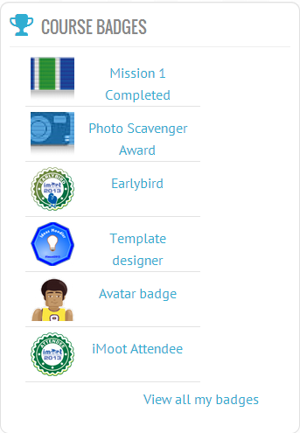
My latest badges
(Moodle block)
Notes:
In Moodle, I can see My latest badges block ((– can be added to My Home as well as to course))
Can see badges earned in this Moodle, and users can also download badges earned from other sites into their Moodle profile.
You can also see public badges of other participants

Slide 20

The process
Teacher creates a badge, adds it to a course
Student earns badge
Uploads it to Backpack
Display badge on LinkedIn, Facebook, Mahara, etc
Notes:
To use badges in Moodle:
Teacher creates a badge, adds it to a course – with criteria for earning it
Student earns badge
Uploads it to Backpack
Display badge on LinkedIn, Facebook, Mahara, Moodle, etc

Slide 21


Create a badge
https://www.openbadges.me/
Notes:
Make a badge https://www.openbadges.me/

Slide 22
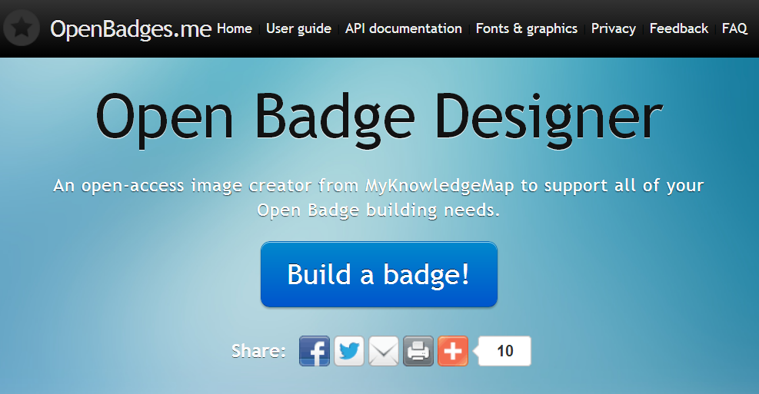
www.openbadges.me
Notes:
www.openbadges.me
Will need to login with email address
badg.us, forallbadges or openbadges.me

Slide 23
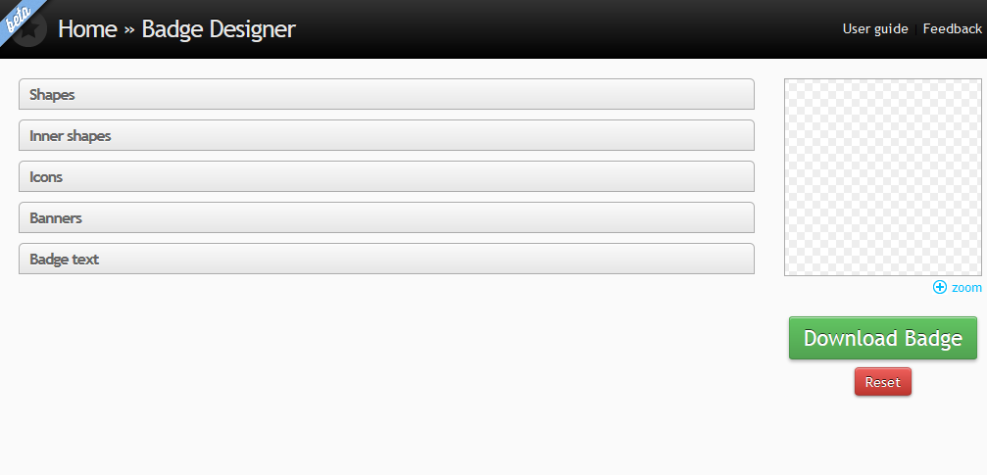
Notes:
Beta version
Click on Shapes…

Slide 24
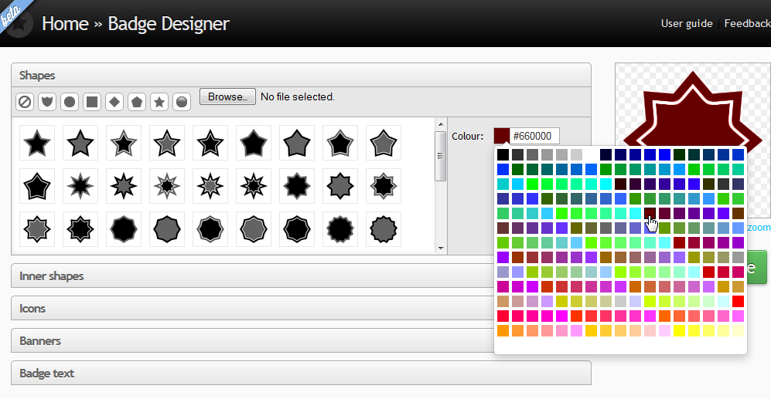
Notes:
Can click on the basic shapes for more
Click on the colour picker to change the colour
If you use your own image – default size 90x90 pixels

Slide 25
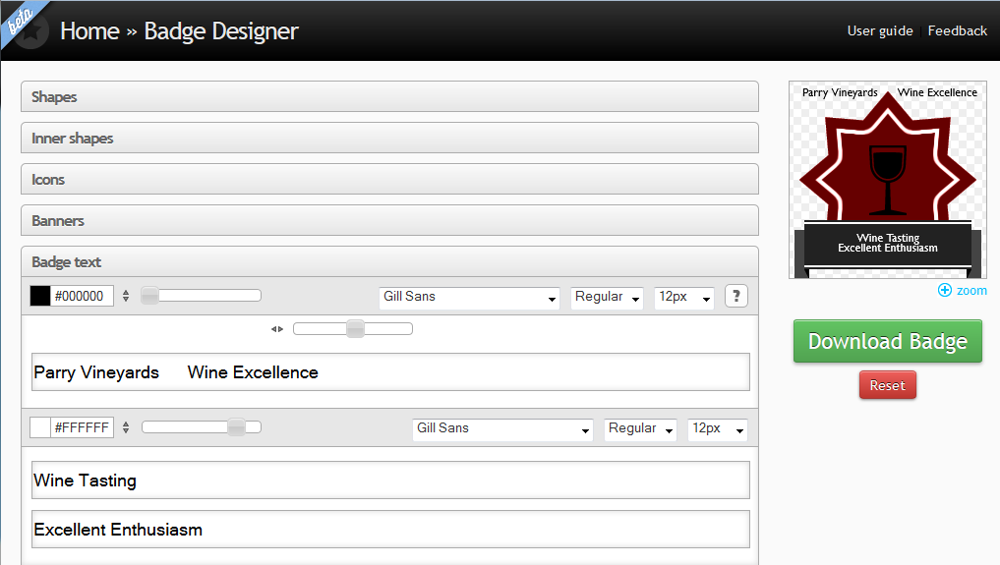
Notes:
Use the sliders to position the text, you can also change font face, size, bold, italic, colour
You can then download the badge – it will be a .png file
Download and open
That is fun ☺

Slide 26
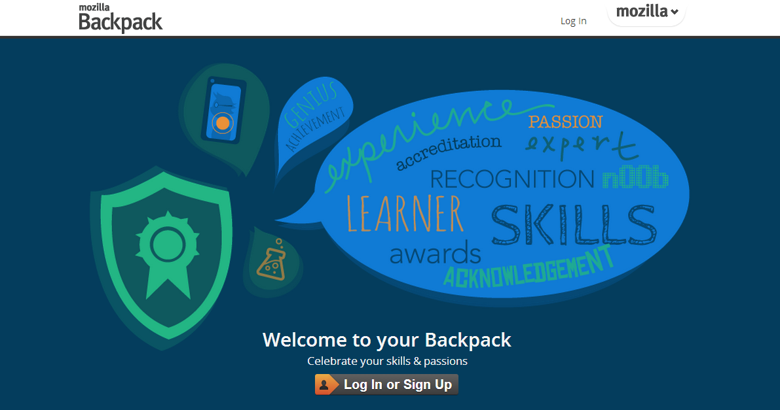
http://backpack.openbadges.org/backpack/login
Notes:
Learners who earn badges can store them in a Mozilla Backpack – currently this is the only place for storing badges – and it is open source, so free to use
http://backpack.openbadges.org/backpack/login
There is a document to accompany this video, so you can get the link from there.

Slide 27
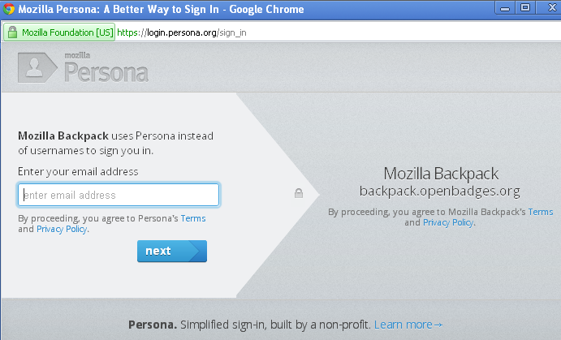
Sign up for an account
Notes:
Add email address and Next
Then add your password, and you will be sent an email for you to confirm the account details.

Slide 28
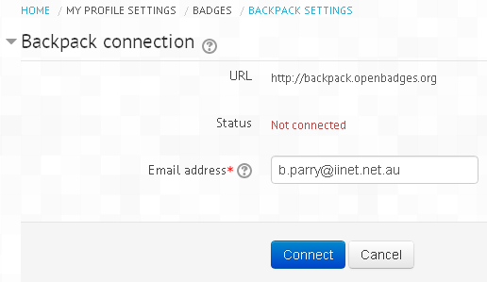
Connect your Moodle badges to your Backpack account
Go to My profile settings> Badges> Backpack settings
Add your email and click Connect
Notes:
In Moodle…

Slide 29
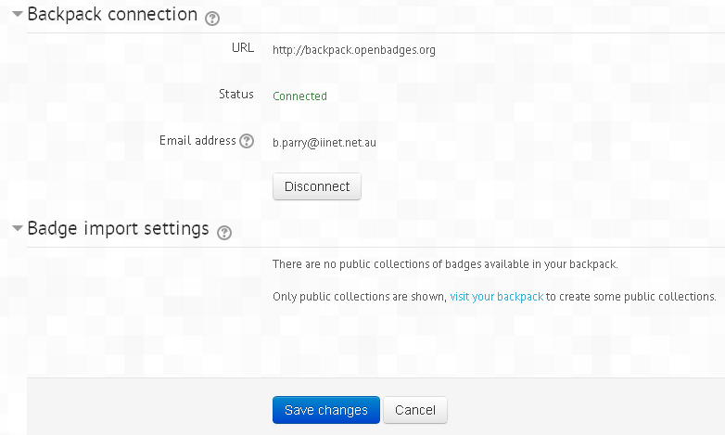
Connected!
Notes:
After backpack connection is successfully established, badges from your backpack can be displayed on your "My Badges" page and your profile page.
In this area, you can select collections of badges from your backpack that you would like to display in your profile.

Slide 30

Click Save changes and you will be taken to My profile> My badges

Slide 31
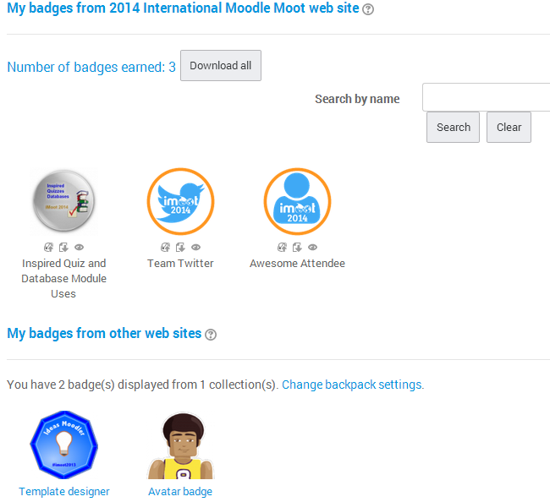
My badges

Slide 32
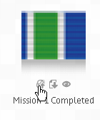
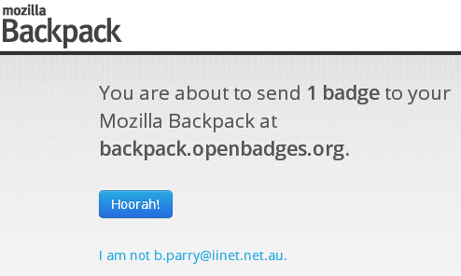
Upload badge to Backpack

Slide 33
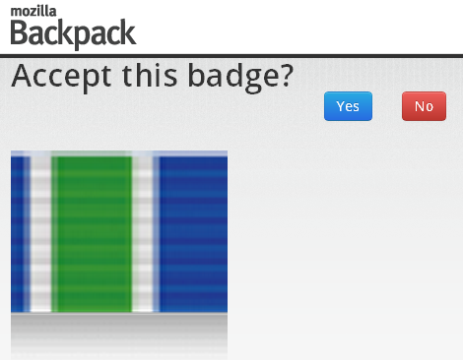

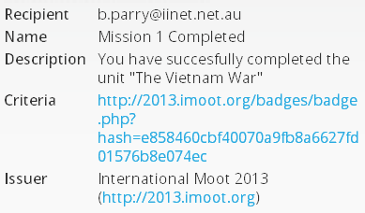

Slide 34
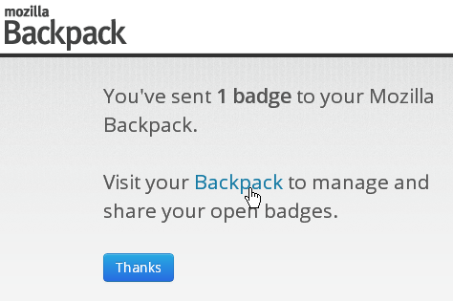
Check Backpack

Slide 35
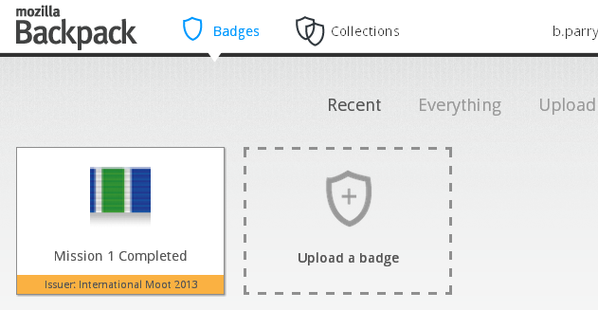

Slide 36
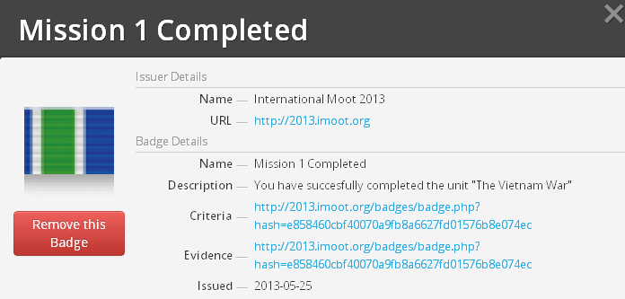
Badge metadata

Slide 37
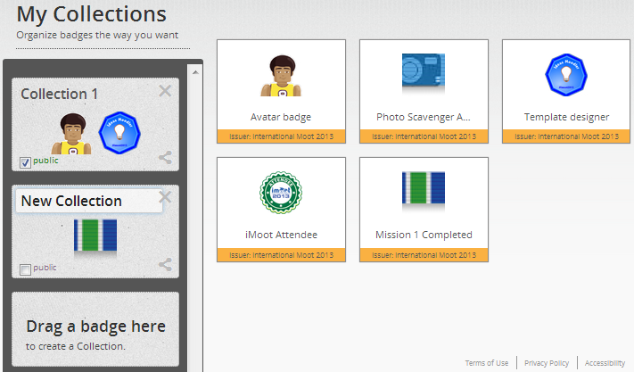
Organise badge backpack
Notes:
Click on actual badge to drag and drop to a collection
Can rename collection by clicking on ‘New Collection’ and typing a new name
Tick the Public box to make the collection public

Slide 38
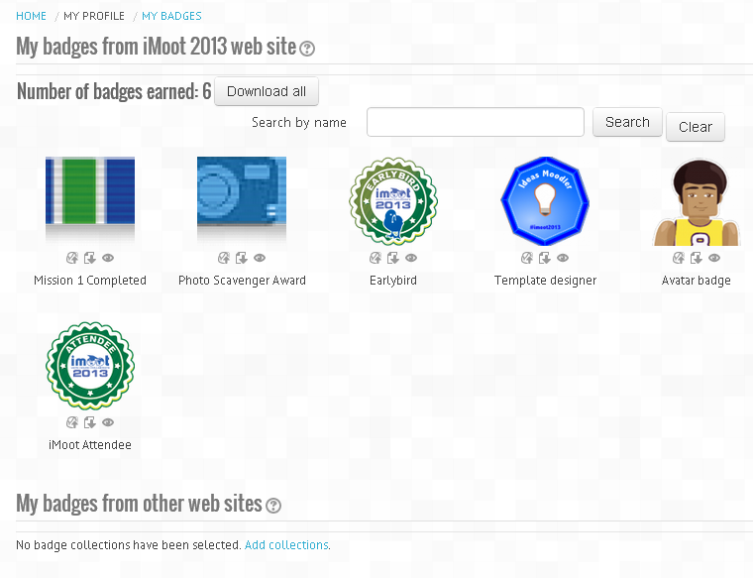
Notes:
Can also:
Download badges to your local computer
Import badges received elsewhere

Slide 39
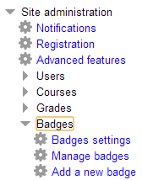
Badge Settings
Notes:
In the Administration block, under Site administration > Badges, TrainingVC administrators can set ‘Badges settings’; this may be to issue a badge on completion of a set of courses
Teachers can set up badges from their course

Slide 40
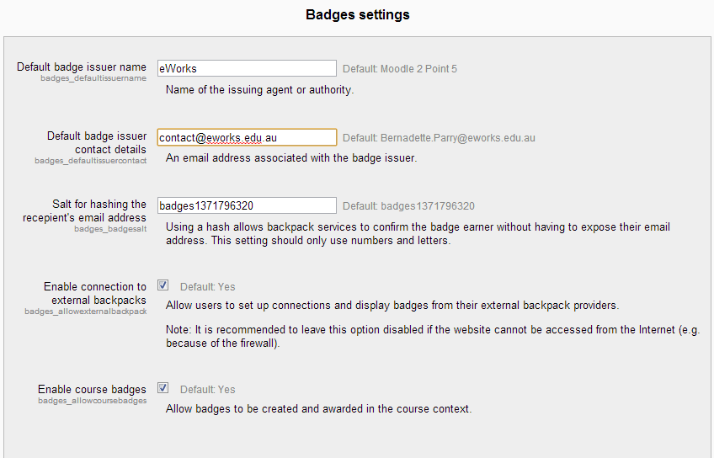
Notes:
For admin to control

Slide 41
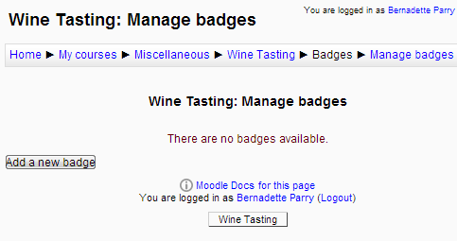
Manage Badges
Notes:
From a course, teachers can Add badges and Manage badges
Before a badge has been issued to at least one user, all its details and settings can be edited.

Slide 42
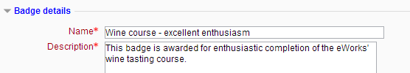
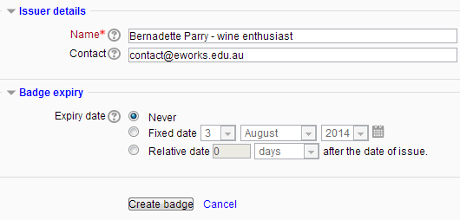
Add a new Badge
Notes:
Go to the course, then Badges> Add a new badge, and complete the settings

Slide 43
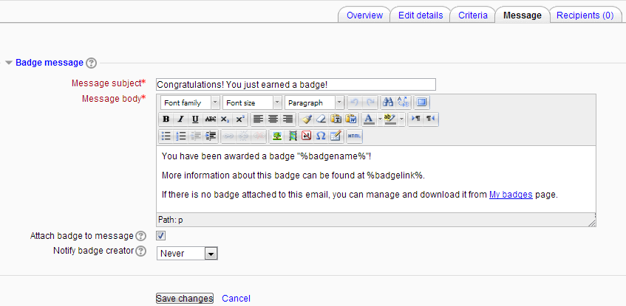
Message
Notes:
Use the tabs along the top to manage the badge

Slide 44
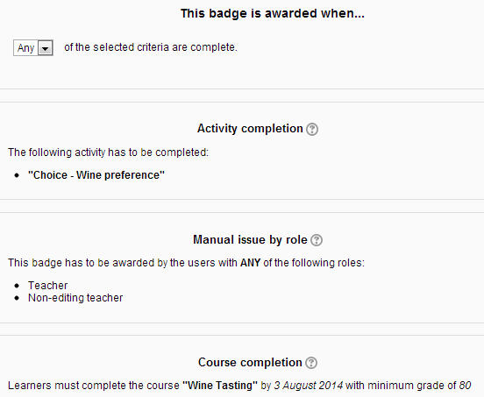
Criteria
Notes:
Criteria
You can allow users with a particular role to manually issue badges;
Or have badges issued on successful completion of the course,
Or on completion of an activity.
Once criteria have been set, you are returned to the Manage badges screen where you must "enable access" for the badge to be available
[[NOTES:
When selecting Manual completion by role, you can choose the role you wish to award the badge, so for example a teacher could allow a non-editing teacher to award badges in the course.
For badges to be awarded for course or activity completion, Completion tracking must be enabled in the site and the course.
Users who issue a badge must have "moodle/badges:awardbadge" capability. ]]

Slide 45
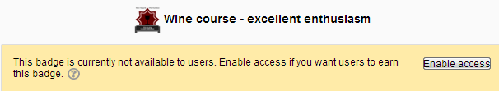
Enable Access
Notes:
You will get a message:
This action will perform a check if any of the users have already completed all the requirements for 'Wine course - excellent enthusiasm' badge?
Would you like to proceed?
NOTE: you need to ‘Disable access’ if you want to edit the badge.

Slide 46
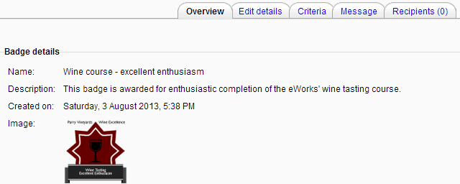

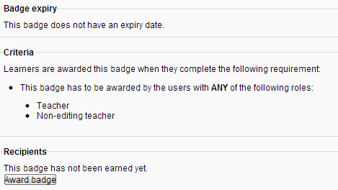
Notes:
If you allow manual issue, then you get a button to ‘award badge’ to individual students
NB Access must be enabled to award a badge..

Slide 47
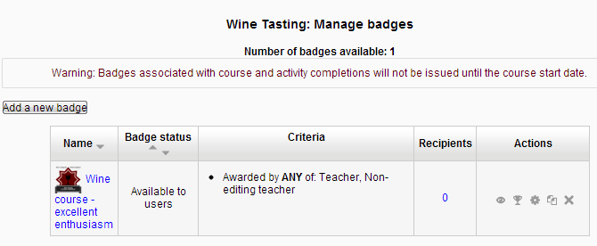

Award badges manually
Notes:
To award badges to students manually, you can click on the ‘award badge’ icon (trophy)
By default, recipients receive an email

Slide 48
Be aware…
Badges can’t be revoked or edited!
Notes:
Currently, once a badge has been issued in Moodle it cannot be revoked – or edited.
So make sure that you are giving a badge to the correct users!

Slide 49
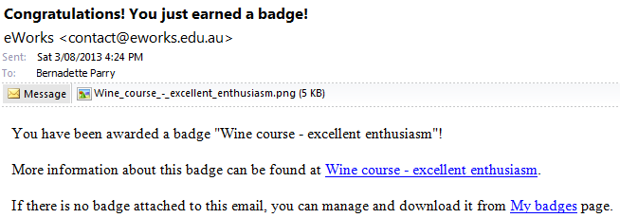
Student View
Notes:
By default, recipients receive an email with the badge attached.

Slide 50
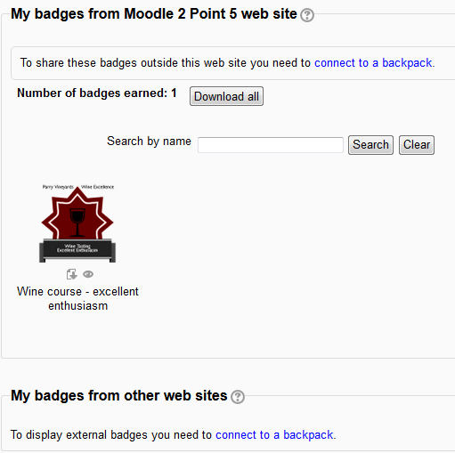
My Badges
Notes:
Student goes to Navigation> My profile> My badges
To connect to a backpack, click ‘connect to a backpack’

Slide 51
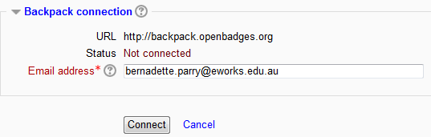
Backpack
Notes:
Click ‘connect’

Slide 52
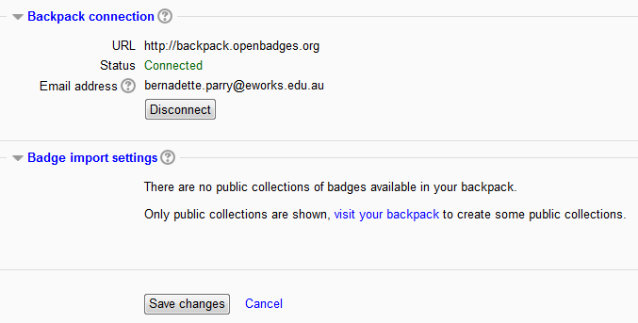

Slide 53
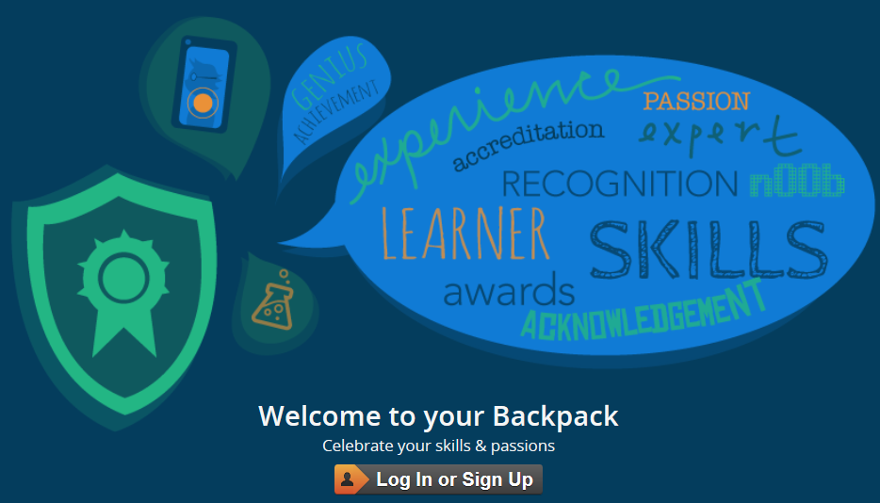
Backpack
Notes:
Backpack connection
If the email address a user has for Moodle is the same as their Open Badges email address, then they will be automatically connected here and may choose to disconnect if they wish. If the email address a user has for Moodle is not the same, then they can add the email address which will connect them to their backpack. They can then choose to "push" to their backpack badges which they have earned on Moodle. The badge must then be added to a public collection for it to be visible on their Moodle profile.
Badge import settings
Here, a user is prompted to choose which public collections to import and display.

Slide 54
Notes
Badge fatigue – don’t use them too randomly, they become ‘noise’

Slide 55
Notes
Badge fatigue – don’t use them too randomly, they become ‘noise’
Good use – eg earn badge when you can use some particular equipment

Slide 56
Notes
Badge fatigue – don’t use them too randomly, they become ‘noise’
Good use – eg earn badge when you can use some particular equipment
Can make it so that two people need to agree to issue it – double checking

Slide 57
Notes
Badge fatigue – don’t use them too randomly, they become ‘noise’
Good use – eg earn badge when you can use some particular equipment
Can make it so that two people need to agree to issue it – double checking
Can’t be withdrawn within moodle (be careful about issuing)

Slide 58
Notes
Badge fatigue – don’t use them too randomly, they become ‘noise’
Good use – eg earn badge when you can use some particular equipment
Can make it so that two people need to agree to issue it – double checking
Can’t be withdrawn within moodle (be careful about issuing)
Can use site-wide badges – eg for finishing a set of courses

Slide 59
iMoot comments
I thought the whole idea with badges was rubbish and then one appeared after I created an avatar and I was excited! So easily led ;)
Notes:
Comments from the iMoot 2013

Slide 60
iMoot comments
I thought the whole idea with badges was rubbish and then one appeared after I created an avatar and I was excited! So easily led ;)
Am spending the coffee break to get as many badges as I can :D

Slide 61
iMoot comments
I thought the whole idea with badges was rubbish and then one appeared after I created an avatar and I was excited! So easily led ;)
Am spending the coffee break to get as many badges as I can :D
As a 41 year old post-grad student... bring on the badges!

Slide 62
iMoot comments
I thought the whole idea with badges was rubbish and then one appeared after I created an avatar and I was excited! So easily led ;)
Am spending the coffee break to get as many badges as I can :D
As a 41 year old post-grad student... bring on the badges!
I think it is a great way to help encourage students to not just complete the bare minimum but to complete something comprehensively.

Slide 63
iMoot comments
I thought the whole idea with badges was rubbish and then one appeared after I created an avatar and I was excited! So easily led ;)
Am spending the coffee break to get as many badges as I can :D
As a 41 year old post-grad student... bring on the badges!
I think it is a great way to help encourage students to not just complete the bare minimum but to complete something comprehensively.
I received my first badge after attending the Big Blue Button training earlier today - glad the webcam wasn't on to capture the ridiculous expression of pure "glee" when I saw it.

Slide 64
iMoot comments
I thought the whole idea with badges was rubbish and then one appeared after I created an avatar and I was excited! So easily led ;)
Am spending the coffee break to get as many badges as I can :D
As a 41 year old post-grad student... bring on the badges!
I think it is a great way to help encourage students to not just complete the bare minimum but to complete something comprehensively.
I received my first badge after attending the Big Blue Button training earlier today - glad the webcam wasn't on to capture the ridiculous expression of pure "glee" when I saw it.
I see a very big potential for badges since you can include the requirements for earning it. This means that it goes way beyond stickers in primary and secondary schools because these badges can be included in e-portfolios, professional websites, etc.

Slide 65
Conclusion
What Open Badges are
Notes:
What Open Badges are:
Badges are distributed online
Open technical standard
Hold information

Slide 66
Conclusion
What Open Badges are
Create a badge
Notes:
How to create a badge – we looked at the www.openbadges.me site

Slide 67
Conclusion
What Open Badges are
Create a badge
Add a badge to a course
Notes:
How a teacher can add a badge to a course – including setting up the criteria

Slide 68
Conclusion
What Open Badges are
Create a badge
Add a badge to a course
How a learner sees and manages badges
Notes:
How a learner sees and manages badges

Slide 69
Conclusion
What Open Badges are
Create a badge
Add a badge to a course
How a learner sees and manages badges
Backpacks
Notes:
Using a Mozilla backpack

Slide 70
Conclusion
What Open Badges are
Create a badge
Add a badge to a course
How a learner sees and manages badges
Backpacks
Some uses, warnings and comments

Slide 71

Notes:
Thank you for listening and I hope you have fun using badges to enhance the learning experience of your learners

